Slide 1
Regis University MSDS696 Data Science Practicum II
Olumide Aluko

Slide 2
Contents
Problem or Situation
Research Question
Data
Proposed Methodology
Project Timeline

Slide 3
Problem or Situation
Rainfall Prediction is a complex and uncertain task that significantly impacts human society.
Well-timed and accurate forecasting can proactively help reduce human and financial loss.
This project presents a set of experiments that use standard machine learning methods to build models that can predict whether it will rain tomorrow or not based on the weather data for that day in major cities in Australia.

Slide 4
Research Question
Can we predict whether it will rain tomorrow or not using data?
Solution: Design a predictive classification model (Decision Tree and Logistics Regression) using machine learning algorithms to forecast whether or not it will rain tomorrow in Australia.

Slide 5
Data
Dataset Source: https://www.kaggle.com/code/ankitjoshi97/rainfall-in-australia-eda-prediction-89-acc/data
The dataset is taken from Kaggle and contains about 10 years of daily weather observations from many locations across Australia.
Dataset Description:
Number of columns: 23
Number of rows: 145460
Number of Independent Columns: 22
Number of Dependent Column: 1

Slide 6
Proposed Methodology
Download dataset
Import data into Jupiter Notebook
Import required libraries
Process data
Perform data Exploration
Clean and remove outliers in data
Find categorical and numerical features in dataset
Split data into training and testing set
Perform feature scaling
Use Decision Tree & Logistic Regression to build a predictive model whether or not it will rain tomorrow.
Summarize results and conclusion

Slide 7
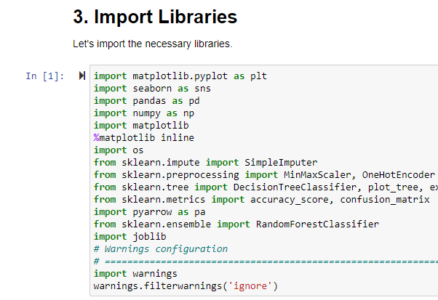
Libraries

Slide 8
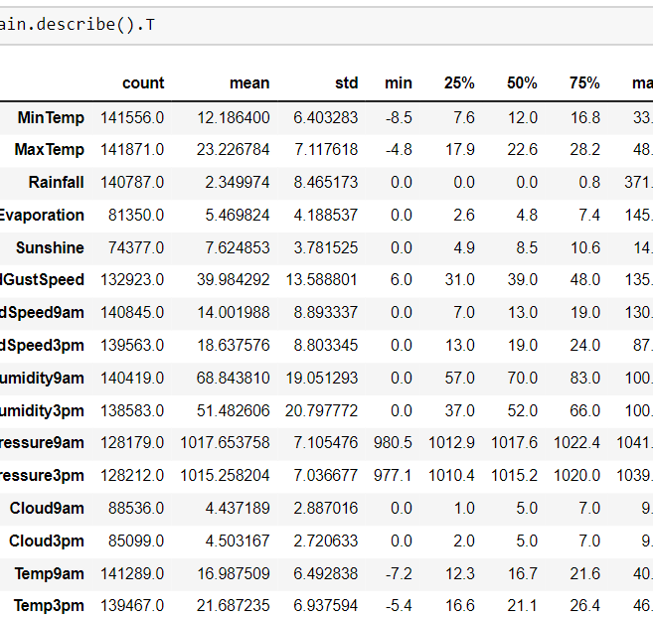
EDA – Summary of Data
Observations:-
The average minimum temperature is 12.19 and average maximum temperature is 23.22-degree Celsius.
The mean rainfall is 2.35 mm. -The average sunshine received is 7.62 hour.
The average wind gust speed is 40.00 km/hr., and the median evaporation is 4.8 mm

Slide 9
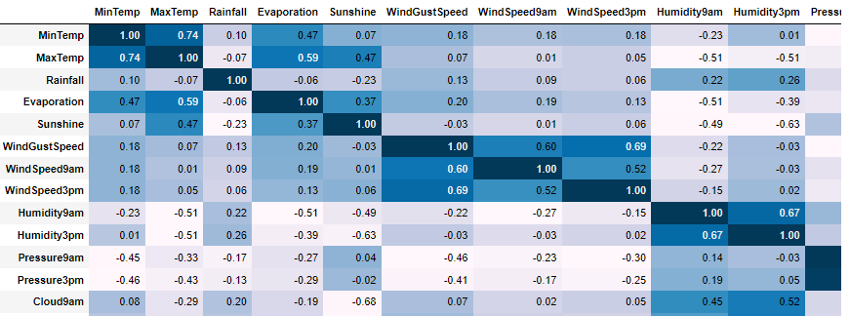
EDA - Correlation
Observations:-
Max Temp and Temp3pm have a strong positive correlation of 0.97.
Pressure9am and Pressure3pm have a strong positive correlation of 0.96.
Min Temp and Temp9am have a strong positive correlation of 0.90.
Max Temp and Temp9am have a strong positive correlation of 0.88.

Slide 10
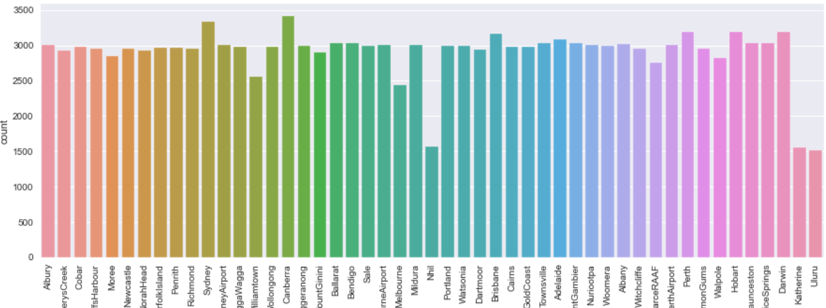
EDA - Distribution of Location
Observations:-
Most occurred location is Canberra followed by Sydney.
Most of the locations have a frequency near 3000.
Nhil, Katherine and Uluru have occurred the least.

Slide 11
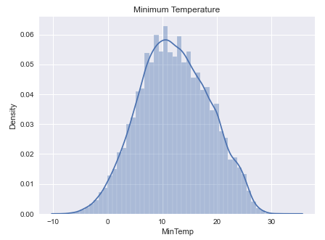
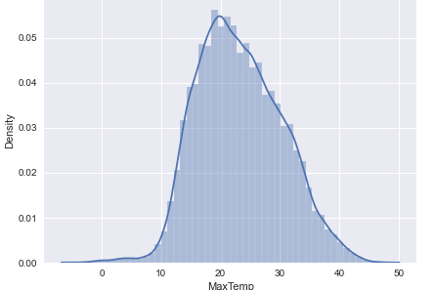
EDA – Min/Max Temp
Observations:-
The Highest concentration of points for minimum temperature is between 10-to-12-degree Celsius.
The Highest concentration of points for maximum temperature is between 18to 22-degree Celsius.

Slide 12
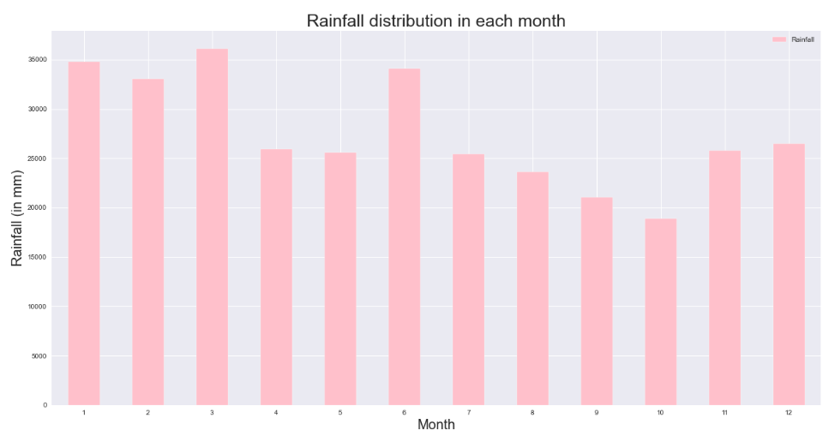
EDA – Rainfall Distribution by Month
Observations:-
Maximum rainfall (greater than 35,000 mm) occurs in March.
January and June also experience high rainfall(nearly 35,000 mm) followed by February.
Minimum rainfall occurs in October followed by September.

Slide 13
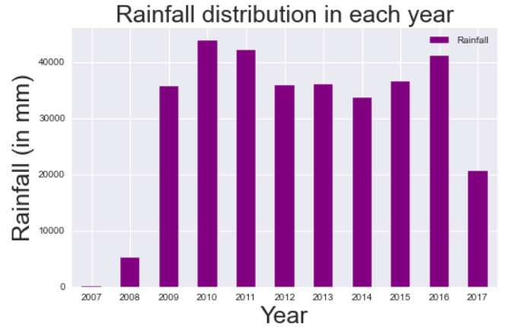
EDA - Rainfall Distribution by Year
Observations:-
Maximum rainfall(greater than 40,000 mm) occurred in 2010 followed by 2011 and 2016.
2009, 2012, 2013, 2014 and 2015 experienced rainfall between 30,000-40,000 mm.
Least rainfall(less than 200 mm) occurred in 2007 followed by 2008 and 2017 (greater than 20,000 mm).

Slide 14
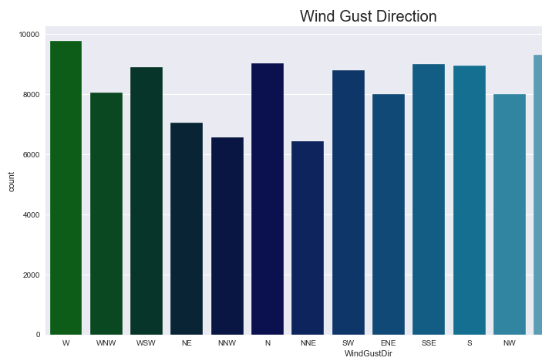
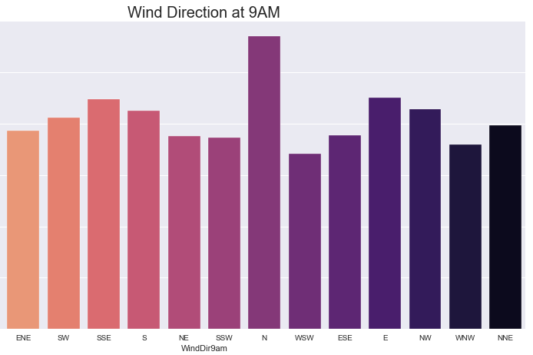
EDA – Wind Gust Direction & Wind Direction at 9AM
Observations:-
Wind Gust Direction for maximum records(nearly 17,500) is West.
Wind Direction at 9AM for maximum records is North followed by North-West and East.

Slide 15
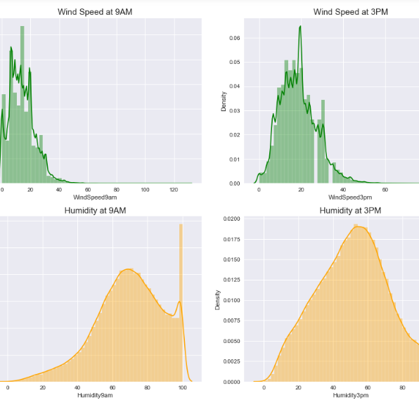
EDA – Wind Speed & Humidity
Observations:-
Maximum wind speed at 9AM ranges from 10 to 20 km/hr. whereas at 3PM it ranges from 15 to 22 km/hr.
Highest concentration of points for humidity at 9AM is between 60-80% whereas at 3PM it's 40-70%.

Slide 16
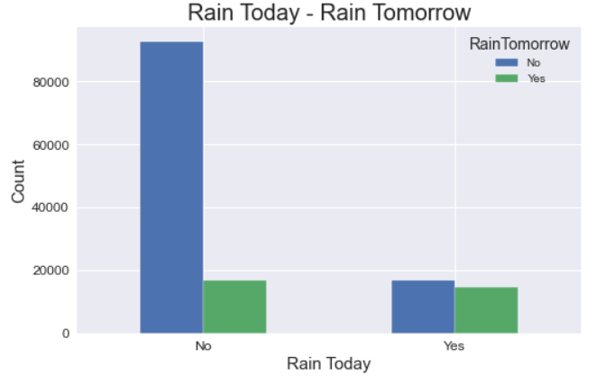
EDA – Rain Today & Rain Tomorrow
Observations:-
For maximum records it didn't rain for both days.
For nearly 20,000 records it didn't rain today but rained tomorrow and rained for both days.
For nearly 20,000 records it rained today but didn't rain tomorrow.

Slide 17
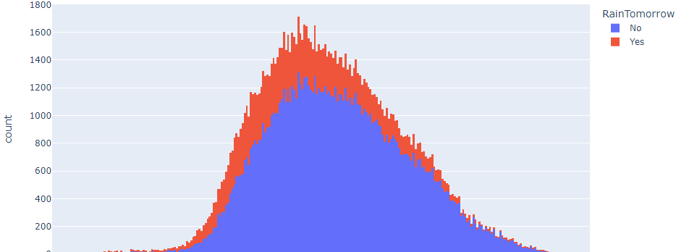
EDA – Temperature at 3 PM VS. Rain Tomorrow
Observations:-
Raintomorrow with "No" has the highest count of 1311 when Temp3pm is between (18.4 – 18.5) Celsius.
Raintomorrow with “YES" has the highest count of 401 when Temp3pm is between (18.4 – 18.5) Celsius.

Slide 18
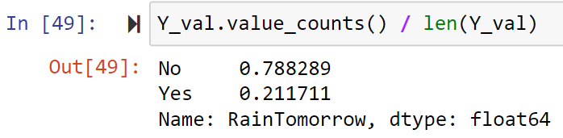
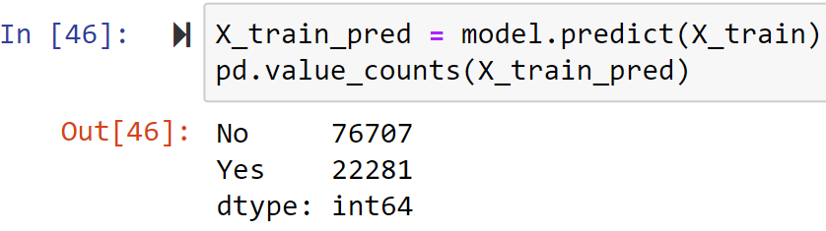
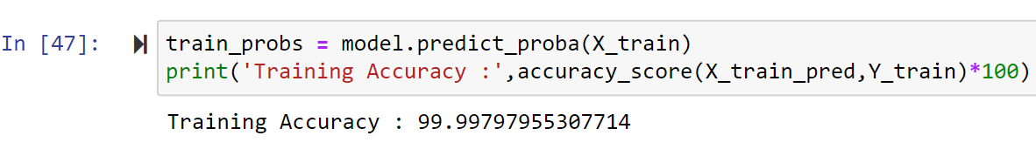
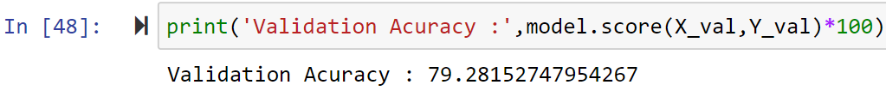
DecisionTree Model Training - Evaluation
Observations:-

Slide 19
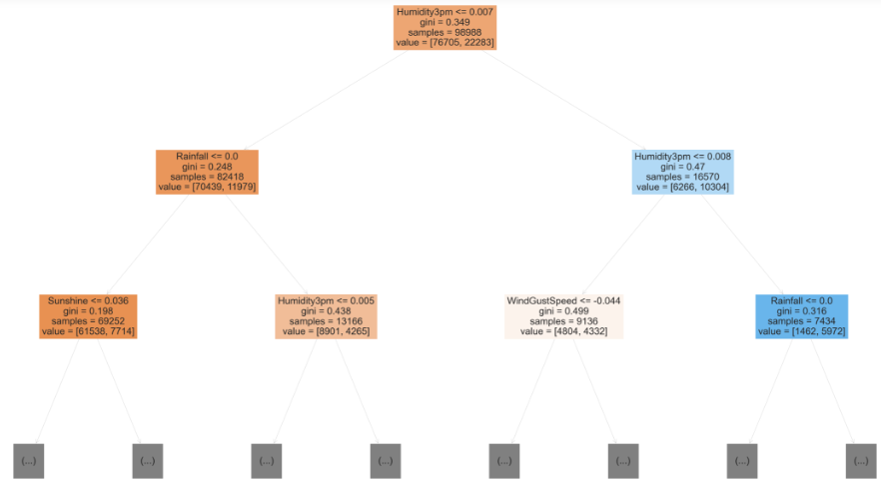
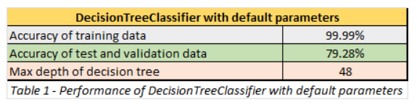
Evaluation – Performance of DecisionTreeClassifier
Observations:-
RainTomorrow shows 78.8% 'No' and 21% 'Yes' in validation data.
The validation accuracy is 79.28
The training set accuracy is 99.99
The above case was an overfitting case as tree used the (max_depth = 48) and memorized the values
And it failed to predict with low accuracy of 79.28% for test and validation dataset

Slide 20
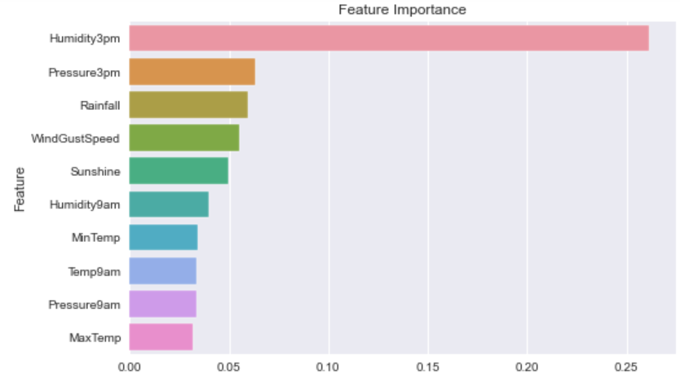
Evaluation – Feature Importance
Observations:-
Humidity3pm has the highest feature importance of 0.27
Pressure3pm and Rainfall has the second highest feature importance of less than 0.10.
MaxTemp has the lowest feature importance of less than 0.05.

Slide 21
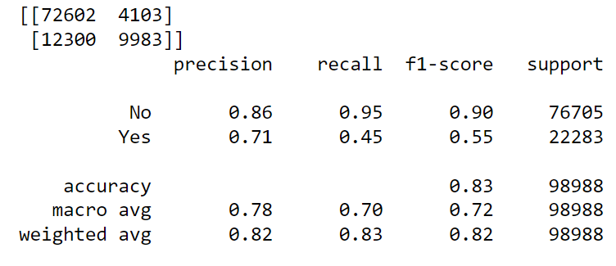
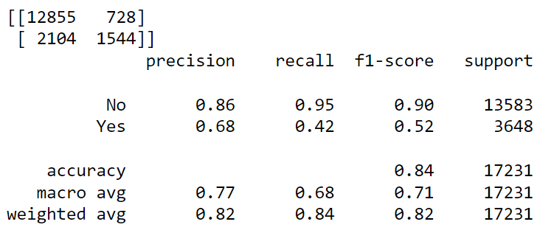
Hyperparameter Tuning – Confusion Matrix for Training & Validation Data
Observations:-
The training accuracy is just 83% which means the model is not memorizing and overfitting the values. See table 1.
The validation accuracy is just 84%. See table 2.
We now have a better performance on training and test dataset.
DecisionTreeClassifier with a (max_depth=4) was utilized.
Table 1: Confusion matrix for training data
Table 2: Confusion matrix for validation data

Slide 22
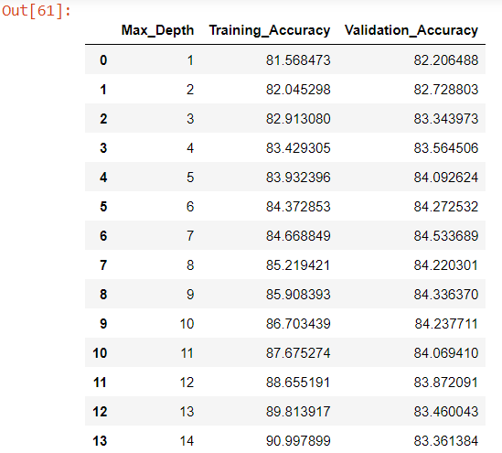
Hyperparameter Tuning – Tuning max_depth
Observations:-
As the max_depth value without manual constraint for which our model overfitted is 48. And the max_depth value can't be 0 or lesser.
Let's find what the best value of max_depth method for which the errors of train and validation dataset is optimal.
From table 1, the training accuracy increases with increase in max_depth.
From Table 1, the validation accuracy first increases and then decreases.
Table 1: Data frame of Training & Validation Accuracy

Slide 23
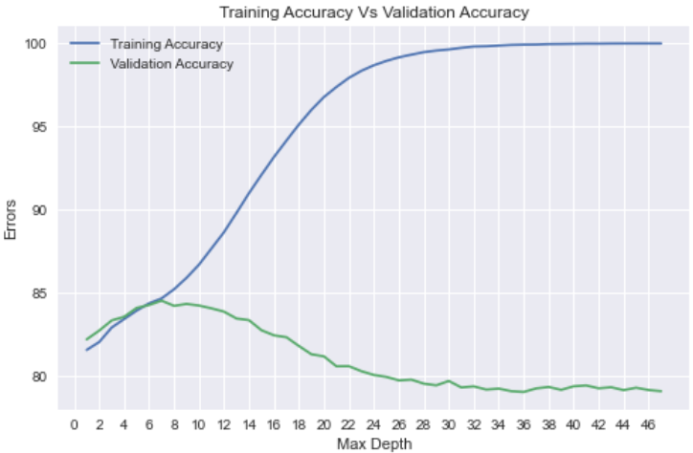
Hyperparameter Tuning – Tuning Graph at (max_depth = 7)
Observations:-
The graph shows that training accuracy increases with increase in max_depth while validation accuracy first increases (till max_depth = 7).
And then decreases. Hence, optimal max_depth is 7.
Build Decision Tree with (max_depth = 7), the training accuracy was 84.66
Build Decision Tree with (max_depth = 7), the validation accuracy was 84.53

Slide 24
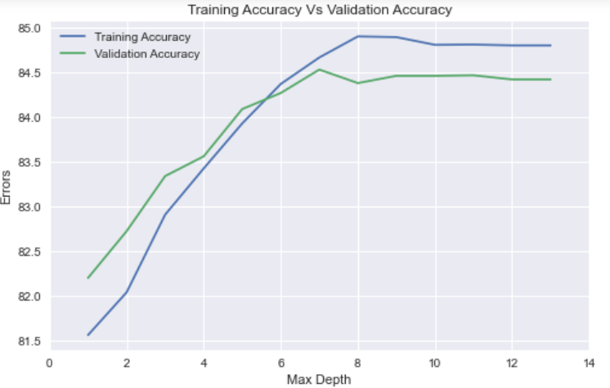
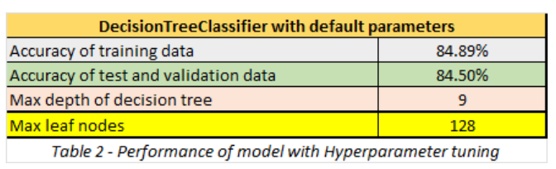
Hyperparameter Adjustment – Tuning Graph at (max_depth = 9)
Observations:-
From the graph, it seems (max_depth = 9) and (max_leaf_nodes = 128) is the optimal hyperparameters.
Build Decision Tree with (max_depth = 9), the training accuracy was 84.89
Build Decision Tree with (max_depth = 9), the validation accuracy was 84.46
From the graph, performance is improved for new predictions as accuracy of training data, test data and validation data is almost the same.

Slide 25
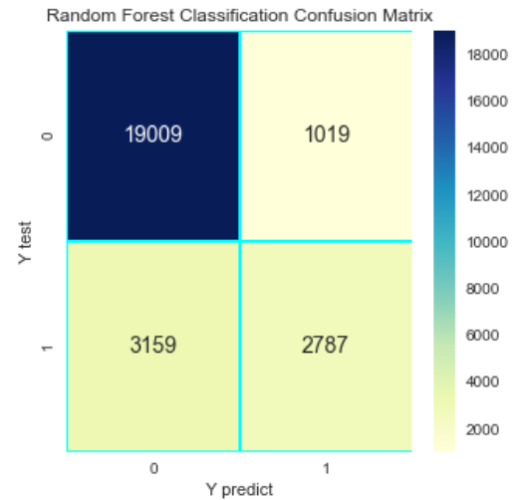
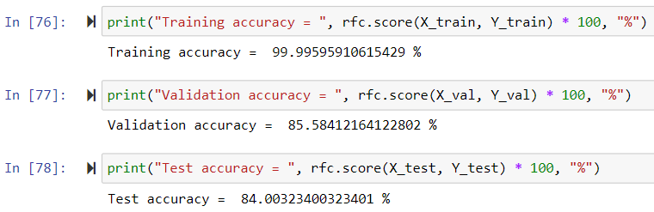
Random Forest Algorithm Training – Model Score
Observations:-
From the output, the RandomForest training accuracy is 99.99%.
The RandomForest validation accuracy is 85.58% & the test accuracy is 84.0%
From the above confusion matrix, there are 19,009 true negative values, 3,159 false negative values, 1,019 false positive values, and 2,787 true positive values.
This proves that the RandomForest is the best model.

Slide 26
Conclusion
For the decision tree model, the training accuracy is 99.99%, validation accuracy is 79.28% and the percentage of 'No' in validation data is 78.8%. Hence, our model is only marginally better than always predicting "No". This occurs because the training data from which our model learned remains skewed towards 'No’ Decision tree overfit.
After an Hyperparameter tuning was applied to make some changes in the parameters of the model training to avoid overfitting. We were able to predict with a training accuracy of 84.89% and validation accuracy of 84.46% using DecisionTree.
The RandomForest has a training accuracy of 99.99% and a validation accuracy of 85.58%. From the performance of the two models, Random Forest is greater than Decision Tree.
Finally, one can establish that the Random Forest model is better in the sense it yields higher accuracy than other models.

